Slide 1
Report from
Cllr Michael Lunn
Wealden District Councillor representing
Hadlow Down and Rotherfield Ward

Slide 2
Headlines
The Council make up has changed significantly
The Council has maintained 2.99% Council tax increase
The community recycling bins at Wilderness Wood removed
Planning enforcement across multiple areas remains challenging
Council committees have been challenging as many new councillors don’t understand how a local District Council works
Many new initiatives happening but nothing really delivered yet.
New environmental improvements licensing proposals

Slide 3
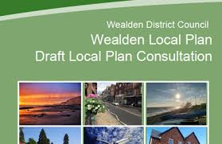
Draft Local Plan Regulation 18 consultation
Public Consultation now open till 5pm on Friday 10th May 2024
Responses must go through the official Councils consultation Portal https://consult.wealden.gov.uk/kpse/event/2726CE98-03BA-4520-8558-361BAA45F784
Impact on Hadlow Down is limited, as village is seen as an unsustainable location for development
Windfall sites will still likely to happen
Hadlow Down mainly impacted by traffic travelling through village from additional developments in Uckfield, Horam, Heathfield and Crowborough
Lots of new planning policy proposals – which I would encourage you to read and submit comments to the planning portal.

