Slide 1
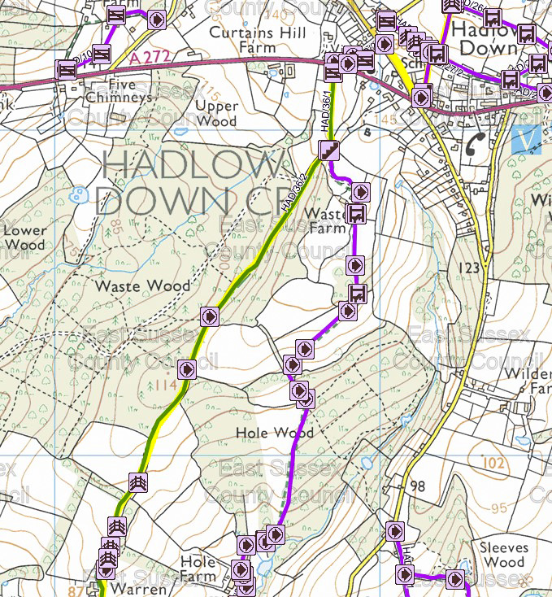
Peter Weston Parish Council Responsibilities
Changes since last Parish Council Assembly: Footpaths to Cllr. Stephen Lester; but will just highlight two issues from earlier in the year:
1)
Peter Weston
The footpath / bridleway [HAD/36/2] from the A272 down past Smile Meadow through Waste Wood to Shepherds Hill – very rutted and boggy in places – dangerous!
Chairman (Cllr. Michael Lunn) and East Sussex Cllr. Bob Standley very active – East Sussex CC saying that it is ‘on the list’ for improvements.
Notes:
Good evening!
My areas of responsibility changed during the year with the appointment of two new Councillors.
Footpaths and byways have now moved to Cllr Stephen Lester.
But would just mention two footpath issues:
First: The wonderfully named HAD/36/2 better known as the footpath and bridleway that goes from just opposite the burial ground down through Waste Wood to Shepherds Hill. As many of you will know at the Waste Wood end there is a deep gully in the middle of the path and lower down it is very boggy making it treacherous for both walkers and riders. This has been a cause of concern for several years, and our Chairman Michael Lunn has taken up the cudgel supported by Cllr Bob Standley and East Sussex CC are now saying it is on the ‘waiting list’ for improvements. We live in hope!!!

Slide 2
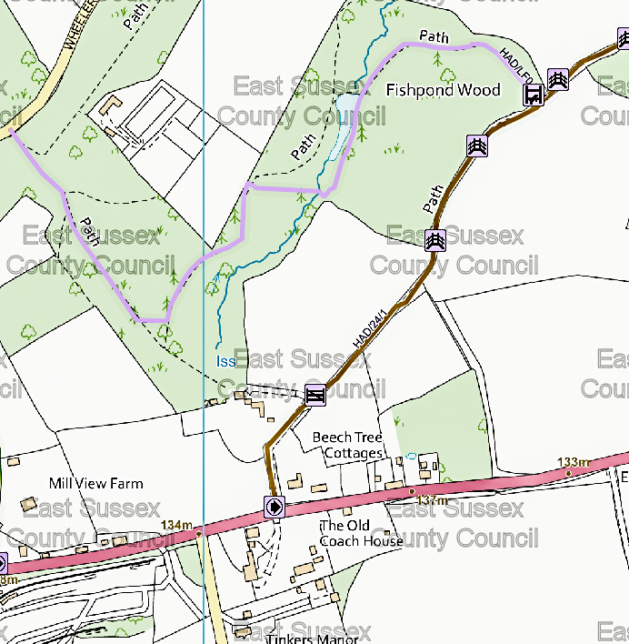
2) The licensed footpath through Fishpond Wood
There are a number of footpaths that come off the ‘BOAT’ (Byway Open to All Traffic) that runs between the A272 and Dog Kennel Lane. A fence has been erected, but the licensed footpath remains open to walkers via a style (and dog gate); and the licensed path sections have been improved. In the past these paths were used by horse riders.
An ancient pond has also been re-established as a nature conservation area.
I include this as several local residents have raised concerns over these access changes.
Peter Weston
Notes:
Second, the track that goes from the A272 jut east of Tinkers Lane heading north to Dog Kennel Lane; this is actually a BOAT (Byway Open to All Traffic); off it are several footpaths including a ‘licensed footpath’. During the year the Fishpond side of the BOAT was fenced off making it inaccessible to horses. But as the slide says the licensed footpath remains open to walkers via a style (and dog gate which was added after the intervention of Cllr Wellman) ); and the licensed path sections have been improved.
An ancient pond has also been re-established as a nature conservation area.
I have included this as several local residents have expressed concerns over the closing off of paths that have been used and open for many years. Many of these paths are not public footpaths BUT “Members of the public can apply for paths that have been used for many years to be re-designated as public footpaths – details of the process on East Sussex CC website and help can be obtained from such organisations as The Ramblers Association – local rep. Val Harris who may be present.

Slide 3
Speed Indicator Signs (SIDs)
The Parish Council now runs two SIDs (many thanks to Steve Godfrey for his fund raising efforts to purchase ‘SID 2’ and his continuing support in managing the two signs!!!) The purpose of the signs is twofold – to influence driver behaviour and to collect vehicle speed data as evidence for the need for greater traffic calming in the village (i.e. to inform the decisions made by East Sussex Highways).
Several local residents have queried why are they moved periodically …
Over the past year the Parish Council has been making a case for changes to be made, two of these are:
a) For vehicles approaching from Buxted on the A272: a graduated reduction in speed limit (as is the case at the other end of the village) rather than a sudden drop from 60 mph to 30 mph.
b) Signage of speed limits into the village from the A267 side: to be improved, and for the East Sussex main Village sign (currently for 40 mph) to be 30 mph.
The response from East Sussex County Council (i.e. the Assistant Director Communities) has been VERY disappointing and has steadfastly ignored such issues as the footpaths that cross the A272 by the Church (used by many, amongst others, children from St. Mark’s School accessing their Smile Meadow facility). BUT, Cllr. Bob Standley has been very supportive and we are hopeful that a site meeting will take place with Nick Skelton (Assistant Director Communities) in the not too distant future.
Mr Skelton has confirmed that “a review of speed limits on the A and B class roads network will include the A272’, and that the assessment ‘will take place Spring/Summer 2024’. Watch this space!!!???
An example of the data that has been presented to East Sussex County Council is shown on the next slide (monthly data is regularly reported in the Parish Magazine).
Peter Weston
Notes:
Now come on to what I spend most of my PC time on; the Speed Indicator Display signs which I will refer to as SIDs.
The PC now operates 2 such signs. The first was purchased in 2021 using CIL monies (Community Infrastructure Levy funding); the second through the generosity of local residents and the fundraising activity of Steve Godfrey, Steve has also continued to give great support to the maintenance of the SID project.
The purpose of the SIDs is twofold. First to act as a traffic calming measure (which it does for some, but not all, drivers). And second, to collect data – they record the speed of each vehicle that comes in range of the radar sensor.
One of the questions I am frequently asked is why are they moved? The first and the predominant reason is that the PC has to seek licenses from East Sussex Highways, these stipulate that a sign can only stay in the same position for 3c months (as an aside the licenses last for two years and the cost of renewal is not insignificant). The second reason is that national research shows that the effectiveness of the signs’ speed calming reduces after a few weeks – this s borne out by our data. So we move them and they have just been moved to School Lane and the other to be west facing outside the Church.
Over the past year or so the PC has been using the data to make the case for two significant changes on the A272.:
a) For vehicles approaching from Buxted on the A272: a graduated reduction in speed limit (as is the case at the other end of the village) rather than a sudden drop from 60 mph to 30 mph. Anyone who has tried to cross the A272 along any of the three footpaths that cross it near the Church will know how perilous this is- including for St Mark’s schoolchildren on the way to their facility at Smile Meadow. The data we have collected does show that the graduated drop from 60 to 50 to 40 to 30 on the other side of the village is more effective at reducing vehicle speed than the sudden drop from 60 to 30 on the west side of the village.
b) Signage of speed limits into the village from the A267 side to be improved, for example, the beginning of the 30 mph zone just east of Wheelers Lane is very poorly signed and it would be far better for the East Sussex main Village sign (currently for 40 mph) to be 30 mph.
Over the past 6 months the response to our various submissions has been escalated to Nick Skelton’s who is the Asst Director for Communities. My view, is that so far his responses have been woeful drawing heavily on a seemingly very flawed policy that drivers will not comply with speed limits if there are no perceived reasons for doing so; for example, the ‘visibility’ of dwellings but nothing whatsoever about footpaths that cross main roads!!! East Sussex Cllr Bob Standley has been very active in supporting our case (thanks for that) and I believe I am right in saying that in a recent conversation Nick Skelton askd where the footpaths are notwithstanding that previous written submissions contained maps and photographs!!!
BUT, I am now hopeful that with Cllr Standley’s active support we can have a site meeting with Nick Skelton. Mr Skelton has also said that East Sussex Highways are currently undertking a review of all speed limits on A and B roads in the County.
WATCH THIS SPACE.

Slide 4
Roads and Drainage
Summary Specific Times of Day | A272 Westbound Wilderness Lane Site
 | A272 Eastbound St Mark’s Church Site
A272 | Total Vehicles | 30 + mph | 35 + mph | 40 + mph
Westbound 06.00 to 09.00 | 57,589 | 63.26% | 35.07% | 14.03%
Westbound 18.00 to 21.00 | 30,848 | 69.80% | 39.54% | 15.18%
Eastbound 06.00 to 09.00 | 56,451 | 64.81% | 40.48% | 18.71%
Eastbound 18.00 to 21.00 | 65,955 | 65.99% | 39.68% | 17.41%
Summary All Times of Day | A272 Westbound Wilderness Lane Site
 | A272 Eastbound St Mark’s Church Site
A272 | Total Vehicles | 30 + mph | 35 + mph | 40 + mph
Westbound 00.00 to 24.00 | 529,812 | 61.83% | 31.84% | 11.22%
Eastbound 00.00 to 24.00 | 225,491 | 61.10% | 24.95% | 14.07%
N.B There are fewer vehicle detections for the St Mark’s Church site as this site came on stream later than the Wilderness Wood site.
Peter Weston
Notes:
I have mentioned on several occasions the data collected by the 2 SIDs; this slide gives a summary (typo – should be 65.99%). I report to every PC meeting and these reports are reproduced in the Parish Magazine. If anyone wants to see the data in more detail just contact me.
One thing I would point out is that the two SID sites on the A272 (St Marks and Wilderness Wood) are equal distance inside the 30 mph zones so that comparisons are more reliable, and show traffic is significantly faster from Buxted - notwithstanding the bend, the crossroads, the dangerous junction with School Lane, footpaths.

Slide 5
Other Issues
Spring Lane ‘rat run’.
Parish Council Risk Assessments: The Parish Council is responsible for a number of ‘assets’ in the village, including finger posts. The condition of all of these assets is assessed on a regular basis and remedial action taken as necessary.
Finance: As part of the Vice-Chair role - to work with the Clerk prior to each Parish Council meeting to ensure all papers are in order (credit to our Clerk, very few questions ever need to be raised).
Peter Weston
Notes:
There are a lot of other issues I could talk about; for example the use of Spring Lane as a ‘rat run’ – although personally I cannot believe that anyone would use it as a shortcut more than once given the appalling state of the road. I was down there again at rush hour this evening ….

