Slide 1
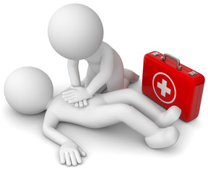
Basic Life Support

Slide 2
Basic Life Support
‘Basic Life Support (BLS) is defined as “maintaining airway patency and supporting breathing and the circulation without the use of equipment other than a protective device.’
Notes:
Ask learner what they think Basic Life Support is?

Slide 3
Secondary Survey (SAMPLE)
1.Head
Signs & Symptoms
Allergy
Medication
Previous medical history
Last meal
Event history
2. Neck
4.Shoulder
Basic Life Support
3. Chest
8. Upper limbs
5. Abdomen
6. Pelvis Lower Back
7. Lower limbs
Notes:
Review SAMPLE
Signs and symptoms – Ask learners what the difference is between a sign and a symptom?
Signs are something you can see: pale, flushed, grey and clammy or blood coming out of a nostril.
Symptoms are only experienced by the person: nausea, anxiety, low back pain, fatigue etc.
Allergies – ask the casualty or look for any bracelets or necklaces
Medication – Again ask or look
Past medical history – Ask the casualty or check for any scars
Last meal – Ask and look
Event history – Look at the area, can you see what's happened by the surroundings? Ask the casualty or any bystanders if they saw what happened?
Conduct a full secondary survey highlighting what you should be looking for as you go…
If time allows, learners can practice this survey, however there is no assessment for this, (verbalising on a manikin during Covid-19).
1&2: Look & feel for any bruising, swelling, deformity, bleeding and for any discharge from the ears or nose, Check pupils, are they equal and reacting to light, re-check airway.
3&4: Compare each side to the other. Does the chest move evenly when breathing? Is there pain on breathing? Look and feel for any bleeding, swelling, pain or deformity
check the back and side.
5&6: Check for any bleeding, swelling, deformity or a response to pain, remember to check the lower back and bottom area. Check pelvis without squeezing or rocking
7&8: If the casualty is conscious ask them to move their arms and legs without causing any pain. Compare one side with the other, check each limb for any bleeding, bruising, swelling and deformity

Slide 4
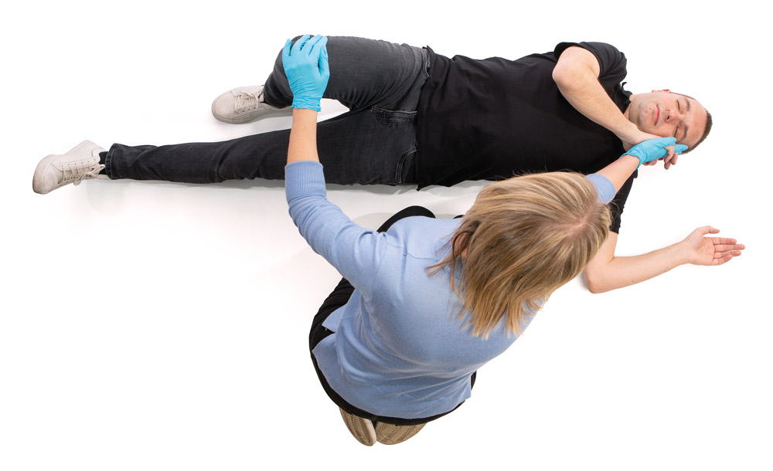
Recovery Position
2
Used to maintain a clear airway
3
1
Basic Life Support
4
CONTINUALLY monitor breathing until help arrives
Notes:
If you suspect spinal injury or moving will make the condition worse, DO NOT MOVE
Prevent Worsening: maintaining a open airway and aids drainage
Promote Recovery: recovery position
If suspected spinal injuries (diving, height accidents) DO NOT move casualty into recovery position. Contact Emergency services.
Remember
Stages 2 and 3 are interchangeable. 3 first with a tall casualty/small first aider
Remove glasses, turn stoned rings inwards
Check pockets
CONTINUALLY monitor breathing until help arrives

Slide 5
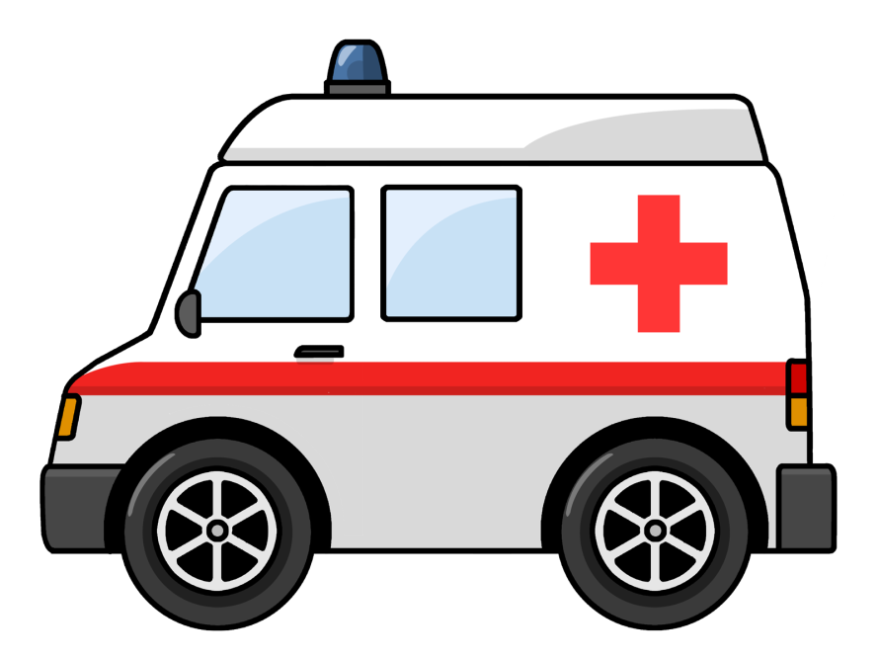
Calling 999/112
Basic Life Support
what3words
GoodSAM
Notes:
Ask if learners have had to phone 999 before, and encourage them to relate their experiences.
Call emergency services if required. If someone else is available ask them to get help, making sure they know what to say to inform the emergency service (Remember if calling 999 from a Barchester building 9 for an outside line!!)
If not breathing:
If possible ring on a mobile with it on speaker phone whilst you commence CPR. Ensure that you inform the emergency services that you have an unconscious casualty that is not breathing. Ask the individual helping you to get an AED if available. Operator will inform caller if there is one near by, there will be a code given to them so they can access the AED.
LIONEL: Location, Incident, Other services, Number of casualties, Extent of injuries, Location (repeat)
Use of WHAT3WORDS App symbol shown
GoodSAM App, provides the ability for those calling the emergency services to instantly share their location and live video from their mobile without an app. The emergency services have sent the link to the caller just to click on to initiate.

Slide 6
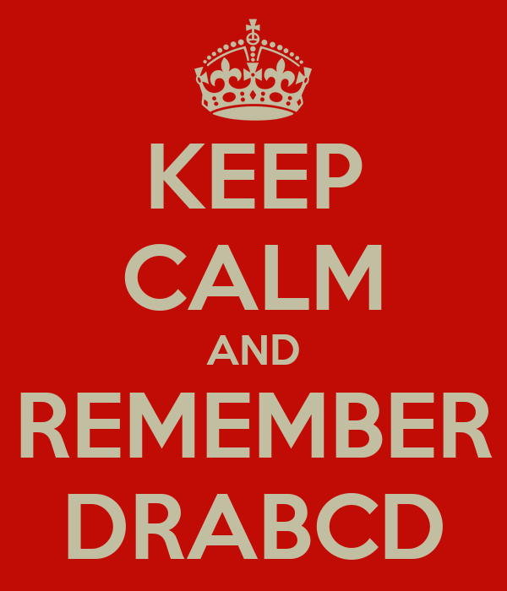
Primary Survey
D
R
A
B
C
D
Danger
Response
Airway
Breathing
CPR
Defibrillation
Basic Life Support
Notes:
Over a third (38%) of UK adults have never undertaken any form of CPR training. Oct.2021 BHF
This is despite a new survey, carried out by YouGov, showing that 82% of UK adults were aware that Christian Eriksen experienced a cardiac arrest at the Euros.

Slide 7
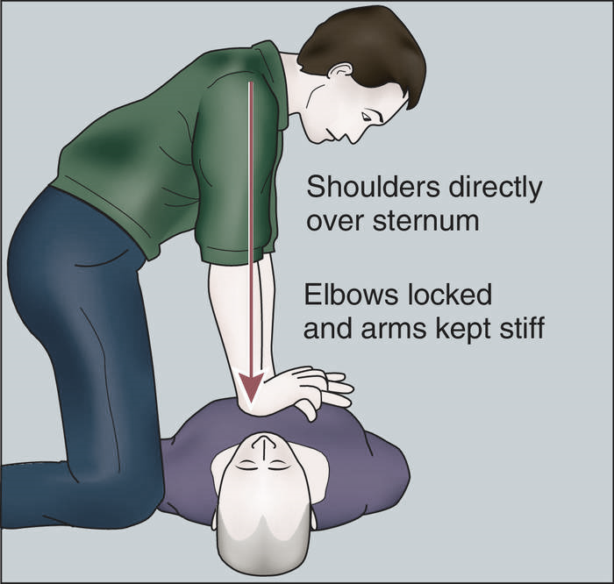
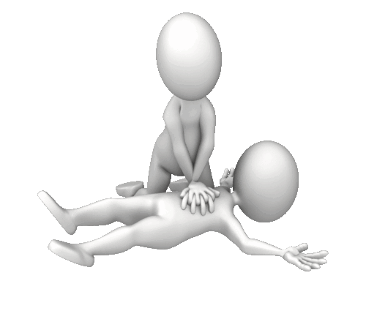
CPR
30 Chest Compressions
Rate 100/120 a min
5 to 6 cm depth
2 rescue breathes
Basic Life Support
Notes:
Talk through what is involved in each technique and demonstrate this on the manikin.
Compressions: Place heal of one hand in the centre of the chest. Place your other hand on top and interlock your fingers.
Keep arms straight and position yourself over the chest. Press down to a depth of 5 – 6 cm and at a rate of 100 – 120 bpm. ( Depth ensures heart is compressed to empty and then refill as pressure relieved.
Ideally needs to be on a firm flat surface (not a bed). If too risky to move casualty, attempting CPR on the bed is better than no CPR at all
Breathes: Head tilt, chin lift and pinch nose. Ensure mouth to mouth seal. Blow steadily for one to one and a half seconds, watch the chest rise and fall
Do not interrupt chest compressions by more than 10 seconds to give 2 breaths

Slide 8
Rate for CPR
A bit slow (100bpm)
Nellie the elephant
Staying alive
A bit Fast (120bpm)
Dynamite (Taio Cruz)
Perfect (110bpm)
Like a Prayer (Madonna)
Everybody (Backstreet boys)
Livin’ on a Prayer (Bon Jovi)
Walking on Sunshine (Katrina and the waves)
Baby Shark (115bpm)
Basic Life Support
Perfect but very inappropriate!
Another one bites the dust (Queen)
Notes:
Compression rate is between 100 and 120 bpm. There are lots of songs with this beat!
Click on each picture for a tune!
If staff have phones with them they could find a song from the list to help understand the rate and then do compressions to it whilst their colleague counts

Slide 9
Defibrillator
Defibrillators are complicated!
You have to be medically trained to use them!
You are jump starting the heart!
You could make things worse!
A Defibrillator will always bring them back to life!
You need to wait until the heart has stopped before using the machine!
Paramedics will always be there before I need to use it!
Basic Life Support
Notes:
Defibrillators are complicated! – They couldn’t be much easier! They speak to you and take you step by step through what you need to do to help save someone’s life
You have to be medically trained to use them! – wrong! They are available for use by the general public. Ideally you would have received training in how to give the best CPR
You are jump starting the heart! – You are not jump starting the heart. Quite the reverse, you are stopping the heart to allow the heart’s natural back-up system to take over and return it to normal sinus rhythm.
You could make things worse! – You cannot use a defibrillator if the casualty does not need it! It will not let you
A Defibrillator will always bring them back to life! – Sadly this is not the case. There are many reasons why someone may experience a sudden cardiac arrest and it is not possible to resuscitate everyone. However, good quality CPR, prompt use of a defibrillator and swift transfer to professional medical care, will give them the best possible chance.
You need to wait until the heart has stopped before using the machine! – Quite definitely not the case. The sooner you use the defibrillator the better their chances of survival. The heart may be in one of the rhythms we discussed on the previous slide VF or VT
Paramedics will always be there before I need to use it! – Sadly this is unlikely as our emergency services are hugely overstretched and it is highly unlikely they would ever be with you within 3 minutes.
National statistics show that the average response time for ambulance services in England were 7 minutes and 19 seconds in February 2020

Slide 10
Using an AED
Basic Life Support
Notes:
You do not need any training to use a defibrillator as it will tell you exactly what you need to do but a lot of people will feel more confident if they are familiar with its use.
Defibrillators are usually located in workplaces, public spaces such as airports, train stations and shopping centres. They may also be labelled PAD public access defibrillators

Slide 11
Using an AED
Basic Life Support
Notes:
Turn the defibrillator on by pressing the green button and follow its instructions.
Peel off the sticky pads and attach them to the patient’s skin, one on each side of the chest, as shown in the picture on the defibrillator. Click
Once the pads have been attached, stop CPR and don’t touch the casualty. The defibrillator will then analyse the casualties heart rhythm. click
The defibrillator will assess whether a shock is needed and if so, it will tell you to press the shock button. An automatic defibrillator will shock the casualty without prompt. Do not touch the casualty while they are being shocked.
The defibrillator will tell you when the shock has been delivered and whether you need to continue CPR.
Continue with chest compressions and rescue breaths until the casualty shows signs of life or the defibrillator tells you to stop so it can analyse the heartbeat again.

Slide 12
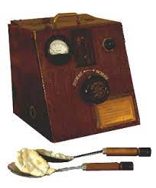
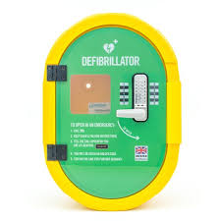
Automated External Defibrillator
The equipment inside most AEDs would normally consist of :
A towel
Spare electrode pads
Reusable Face Mask
Pair of Powder Free Nitrile Gloves
Moist Alcohol Free Wipes
Disposable Razor
Tuff cut scissors
Basic Life Support
Notes:
1947 a 14-year-old patient’s heart stopped during surgery. Out of desperation, Claude Beck ordered that his research unit be brought up from the hospital’s basement. This simple defibrillator consisted of a transformer to isolate the patient from the 110-volt ac wall supply, a variable resistor to limit the current to a heart-safe value, and two metal tablespoons with wooden handles to deliver the jolt to the exposed heart. The first shock failed but the 2nd brought the teenager back to life. Prior to this Beck had been researching delivering shocks to exposed animal hearts.
The Defibrillators Availability Bill was first read in Parliament in 2018 and not only recognises the need for AEDs in public places but also legislates for awareness and training to ensure people are ready to use them. Since September 2020, CPR has become a mandatory topic on the National Curriculum in England. Consequently, all young people in England should have learnt how to give CPR and use a defibrillator by the time they leave secondary school. Hopefully this will dramatically improve our survival rates from out of hospital cardiac arrests, to the same extent as it has in Denmark and other Scandinavian countries.
Defibfinder.uk – enter postcode and it tells you where nearest Defib is

Slide 13
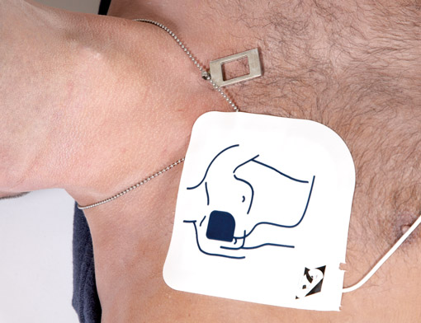
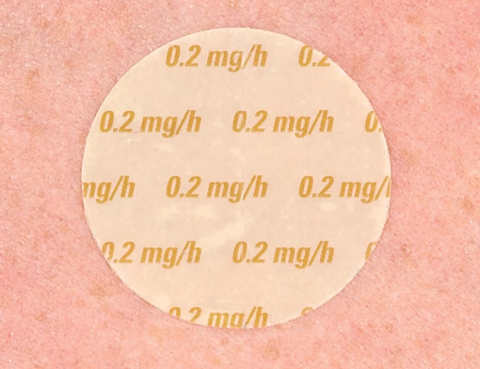
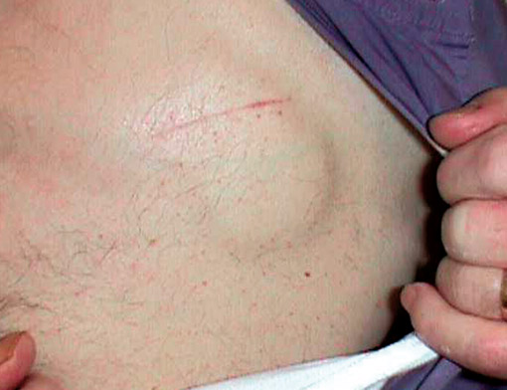
Remember the 7 P’s
When using an AED you need to consider the following:
Patches
Piercing
Playtex/Push up
Pacemaker
Pendant
Pretty Hairy
Perspiration
Basic Life Support
Notes:
Medication Patches: Remove and wipe the area dry
Piercings: Do not waste time trying to remove
Playtex/Push up: All underwired bras should be cut through the centre and moved to one side
Pacemaker: Be aware of pacemaker sites just below the skin. Usually left upper side of chest below collar bone but may be placed on right side for medical reasons. If this is the case place the pad below the site or use pads front and back
Pendants: Move and neck jewellery away from location of pad placement
Pretty Hairy: Shave area quickly if casualty has a lot of chest hair that would prevent the pads sticking
Perspiration: Dry the area where the pads are to be put if the casualty is sweating or wet

Slide 15
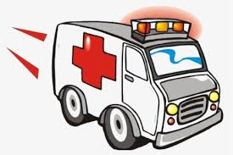
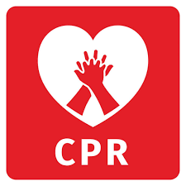
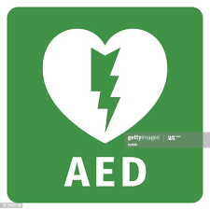
Chain of Survival
999
112
Basic Life Support
Early Call
for help
Early CPR
A E D
Early
Advanced Care
Notes:
In order to maintain the oxygen supply to the body a person must be breathing effectively and their heart must be pumping. If either of these stop, the heart and brain will quickly deteriorate. If a casualty suffers a cardiac arrest, there is a sequence of events that must happen in order for them to have a chance of survival.
Early recognition and call for help: If you think a casualty might have a cardiac arrest then call for help before they collapse.
Early CPR: before the ambulance arrives has been proven to double or triple the chances of survival
Early AED: can dramatically increase the chances of survival if a casualties heart stops beating, but it must be used promptly. For every one minute delay in delivering the shock, the chance of survival reduces by up to 10%. Defibrillation stops the heart to allow it to restart in normal rhythm
Early advanced care: from the ambulance services and hospital is essential to reduce the effects of the arrest and stabilise the casualty’s condition

